Slide 1

Floating-Point Square root
Team members:
Ho hai cong thuAn – 18521469
Ha kieu trang – 18521522

Slide 2
Floating-Point Square root
Team members:
Hồ Hải Công Thuận – 18521469
Hà Kiều Trang – 18521522

Slide 3
Contents
Algorithm
Datapath
Controller (FSM)
Simulation result

Slide 4
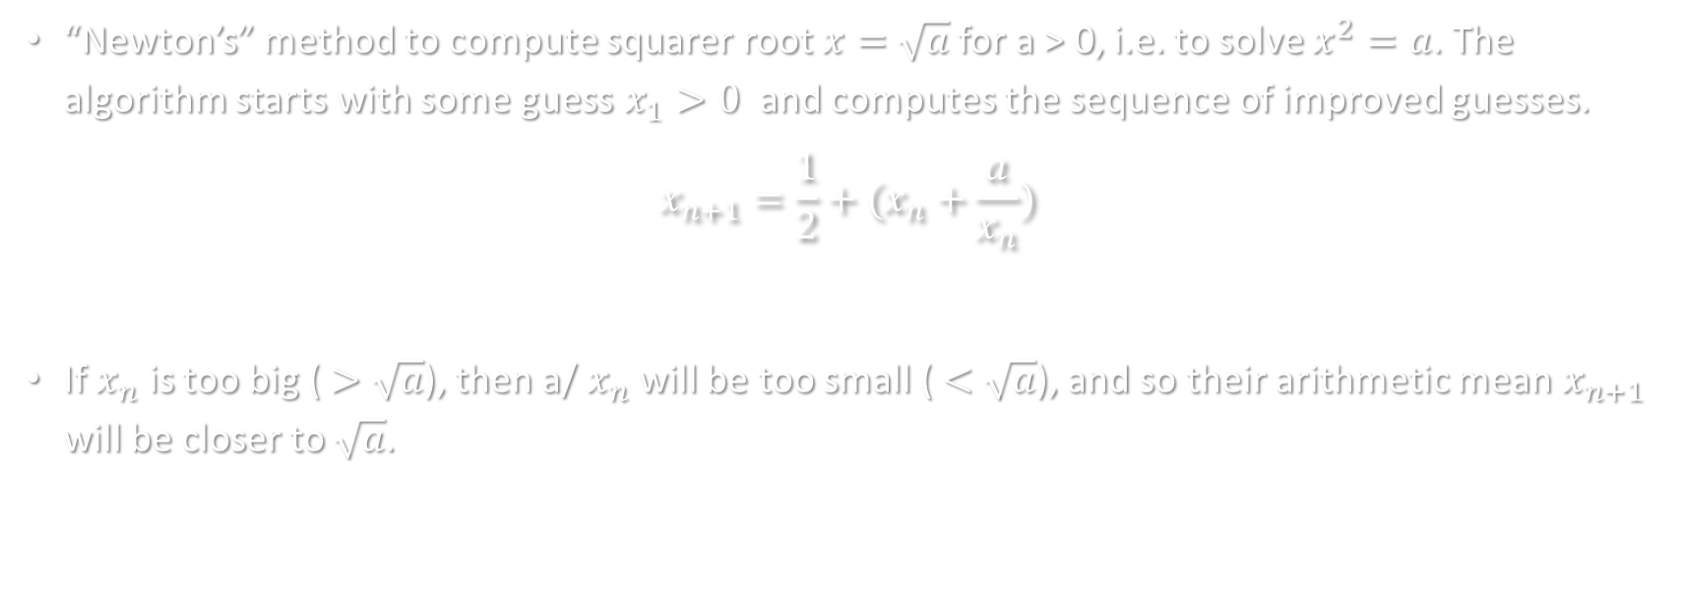
1. Algorithm
“Newton’s” method to compute squarer root $x=$ $\sqrt{a}$ for a > 0, i.e. to solve $x^{2}=a$. The algorithm starts with some guess $x_{1}>0$ and computes the sequence of improved guesses.
$$x_{n+1}=\frac{1}{2}+(x_{n}+\frac{a}{x_{n}})$$
If $x_{n}$ is too big ($>\sqrt{a}$), then a/ $x_{n}$will be too small ($<\sqrt{a}$), and so their arithmetic mean $x_{n+1}$ will be closer to $\sqrt{a}$.

Slide 5
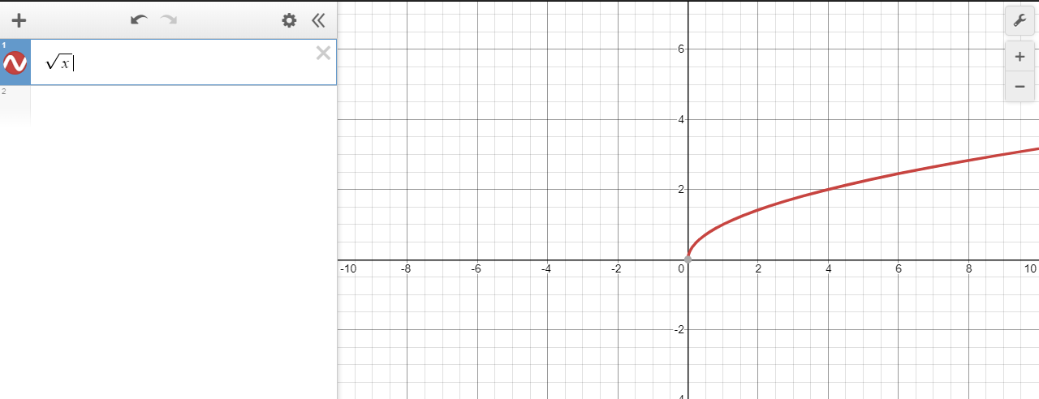
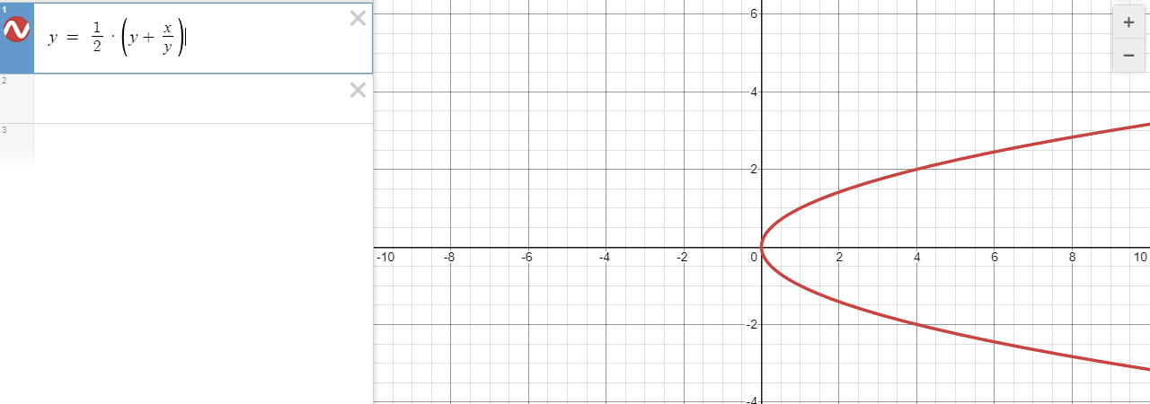
1. Algorithm
Demo on https://www.desmos.com/calculator

Slide 6
1. Algorithm
Proof with testcase using C++
STT | Input | Result from math.sqrt() | Result from the algorithm | Error
1 | 0.0001 | 0.01 | 0.01 | 0.0
2 | 0.0002 | 0.01414213562373095 | 0.01414213562373095 | 0.0
3 | 0.00030000000000000003 | 0.017320508075688773 | 0.017320508075688773 | 0.0
4 | 0.0004 | 0.02 | 0.02 | 0.0
… | … | … | … | …
97 | 0.009699999999999997 | 0.09848857801796103 | 0.09848857801796103 | 0.0
98 | 0.009799999999999996 | 0.09899494936611664 | 0.09899494936611664 | 0.0
99 | 0.009899999999999996 | 0.09949874371066197 | 0.09949874371066197 | 0.0
100 | 0.009999999999999995 | 0.09999999999999998 | 0.09999999999999998 | 0.0

Slide 7
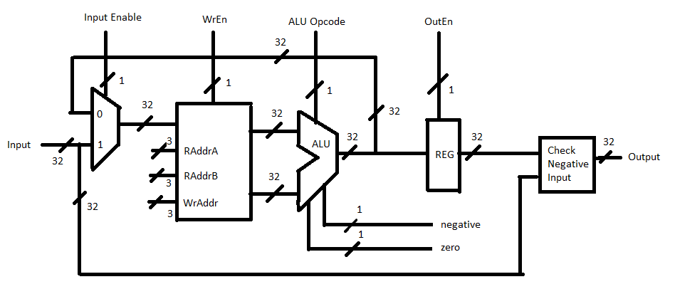
2. Datapath

Slide 8
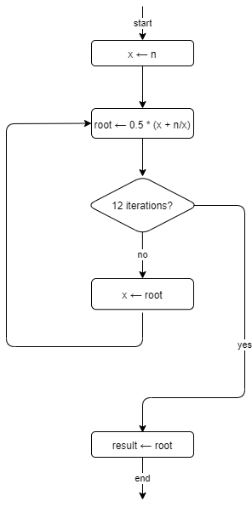
3. Controller (FSM)
S0: Initial state S1: Input number n
S2: x = n;
S3: root = n / x;
S4: root = root + x;
S5 : root = root / 2;
S6: x = root
S7: 12th iteration?
S8: result = root

Slide 9
3. Controller (FSM)
ALU's capable of doing the following operations: add, divide 2 floating-point numbers, divide by 2 (this could be achieved by simply decreasing the exponent by 1).
ALU's flags:
zero: = 1 when ALU's result is 0
negative: = 1 when ALU's result is < 0

Slide 10
3. Controller (FSM)
We need 6 register files:
RF[0] = 0
RF[1] = n
RF[2] = x
RF[3] = root
RF[4] = 2
RF[5] = result

Slide 11
3. Controller (FSM)
State | IE | Cho phép nhập (WE) | Địa chỉ ghi (ADDR_WR) | Địa chỉ đọc A (ADDR_RDA) | Địa chỉ đọc B (ADDR_RDB) | Thao tác ALU (Opcode) | Cho phép xuất (OE)
0 | 0 | 0 | None | Don’t care | Don't care | Don’t care | 0
1 | 1 | 1 | n | Don’t care | Don’t care | Don’t care | 0
2 | 0 | 1 | x | n | 0 | ADD | 0
3 | 0 | 1 | root | n | x | DIV | 0
4 | 0 | 1 | root | root | x | ADD | 0
5 | 0 | 1 | root | root | 2 | DIV | 0
6 | 0 | 1 | x | root | 0 | ADD | 0
7 | 0 | 0 | result | root | 0 | ADD | 1

Slide 12
3. Controller (FSM)
ADDR_WR | REG
0 (000) | 0
1 (001) | n
2 (010) | x
3 (011) | root
4 (100) | 2
5 (101) | result
State | IE | Allow input(WE) | Writting address (ADDR_WR) | Reading Address A (ADDR_RDA) | Reading Address B (ADDR_RDB) | ALU actions (Opcode) | Output Enable (OE)
0 | 0 | 0 | 000 | 000 | 000 | 0 | 0
1 | 1 | 1 | 001 | 000 | 000 | 0 | 0
2 | 0 | 1 | 010 | 001 | 000 | 0 | 0
3 | 0 | 1 | 011 | 001 | 010 | 1 | 0
4 | 0 | 1 | 011 | 011 | 010 | 0 | 0
5 | 0 | 1 | 011 | 011 | 100 | 1 | 0
6 | 0 | 1 | 010 | 011 | 000 | 0 | 0
7 | 0 | 0 | 111 | 011 | 000 | 0 | 1
Opcode | ALU (FP)
0 | Add
1 | Divide
States
S1: Input number n
S2: x = n;
S3: root = n / x;
S4: root = root + x;
S5 : root = root / 2;
S6: x = root
S7: result = root

Slide 13
4. Simulation result
Case: 1 number after semicolon
STT | Integer | Result from math.sqrt() | Result from circuit | Error
1 | 0.1 | 0.31622776601683794 | 0.3162277340888977 | 3.192794023609835e-08
2 | 0.2 | 0.4472135954999579 | 0.4472135603427887 | 3.515716923141454e-08
3 | 0.3 | 0.5477225575051661 | 0.5477225184440613 | 3.9061104795123924e-08
4 | 0.4 | 0.6324555320336759 | 0.6324554681777954 | 6.38558804721967e-08
5 | 0.5 | 0.7071067811865476 | 0.5303301215171814 | 0.17677665966936618
… | … | … | … | …
96 | 9.6 | 3.0983866769659336 | 3.098386526107788 | 1.5085814553117416e-07
97 | 9.7 | 3.1144823004794873 | 3.1144821643829346 | 1.3609655269419818e-07
98 | 9.8 | 3.1304951684997055 | 3.130495071411133 | 9.708857273693638e-08
99 | 9.9 | 3.146426544510455 | 3.146426200866699 | 3.4364375567363936e-07
100 | 10.0 | 3.1622776601683795 | 3.1622774600982666 | 2.0007011292122456e-07
Average Error: |  |  |  | 0.005303449494307858

Slide 14
4. Simulation result
Case: 2 number after semicolon
STT | Integer | Result from math.sqrt() | Result from circuit | Error
1 | 0.01
2 | 0.02
3 | 0.03
4 | 0.04
5 | 0.05
… | …
96 | 0.96
97 | 0.97
98 | 0.98
99 | 0.99
100 | 1.00
Average Error:

Slide 15
4. Simulation result
Case: 3 number after semicolon
STT | Integer | Result from math.sqrt() | Result from circuit | Error
1 | 0.001
2 | 0.002
3 | 0.003
4 | 0.004
5 | 0.005
… | …
96 | 0.096
97 | 0.097
98 | 0.098
99 | 0.099
100 | 0.100
Average Error:

Slide 16
4. Simulation result
Case: Input is a negative number.
STT | Integer | Result from math.sqrt() | Result from circuit | Error
1 | -0.1
2 | -0.2
3 | -0.3
4 | -0.4
5 | -0.5
… | …
96 | -9.6
97 | -9.7
98 | -9.8
99 | -9.9
100 | -10.0
Average Error:

Slide 17
4. Simulation result
STT | Case name | Longest time between input and output (ps)
1 | Input = x.0 (eg 1.0, 2.0,…) | 28414
2 | Input = x.0y (eg 1.01, 1.02,…) | 23930
3 | Input = x.00y (eg 1.001, 1.002,…)
4 | Input = x.000y (eg 1.0001, 1.0002…)
5 | Input = -x.0 (eg -1.0, -2.0,…)

Slide 18

4. Simulation result
Frequency = 1 / Max (the longest time between input and output)
= $\frac{1}{28414 ∗{10}^{−12}}$ = 35193918.49 (Hz)
Number of cycle: 4

Slide 19
4. Simulation result
Case: Input = x.0 (eg 1.0, 2.0,…)
STT | Integer | Binary | Expected result | Expected result binary | Result integer | Result binary | Tolerance
1 | 1.0 | 0 10000000 00000000000000000000000 | 3.0 | 0 10000000 10000000000000000000000 | 3.0 | 0 10000000 10000000000000000000000
2
3
4
5

Slide 20
4. Simulation result
Case Input = x.0y (eg 1.01, 1.02,…)
STT | Integer | Binary | Expected result | Expected result binary | Result integer | Result binary | Tolerance
1
2
3
4
5

Slide 21
4. Simulation result
Case Input = x.00y (eg 1.001, 1.002,…)
STT | Integer | Binary | Expected result | Expected result binary | Result integer | Result binary | Tolerance
1
2
3
4
5

Slide 22
4. Simulation result
Case Input = x.000y (eg 1.0001, 1.0002…)
STT | Integer | Binary | Expected result | Expected result binary | Result integer | Result binary | Tolerance
1
2
3
4
5

Slide 23
4. Simulation result
Case Input = -x.0 (eg -1.0, -2.0,…)
STT | Integer | Binary | Expected result | Expected result binary | Result integer | Result binary | Tolerance
1
2
3
4
5

Slide 24
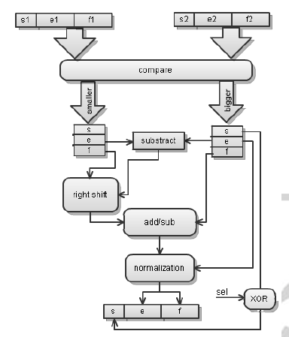
1. Algorithm
Adder

Slide 25
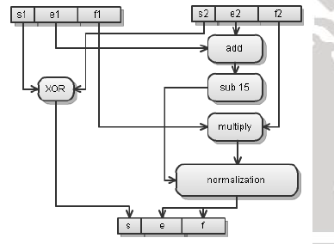
1. Algorithm
Multiplier

Slide 26
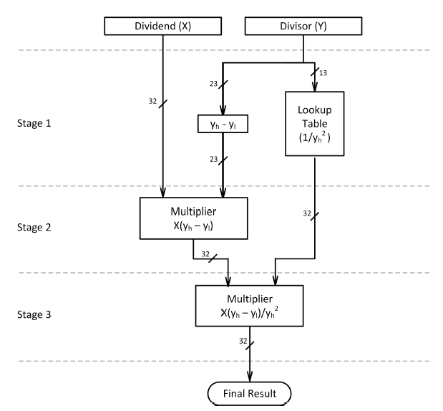
1. Algorithm
Division

